Slide 1

UML
UML and Use Case Diagrams
Actors and System Boundaries
Guidelines
Summary
Object Oriented Software Engineering
Lecture 2: Use Case Modelling
School of Computing, National College of Ireland
Lecture 2: Use Case Modelling Object Oriented Software Engineering

Slide 2
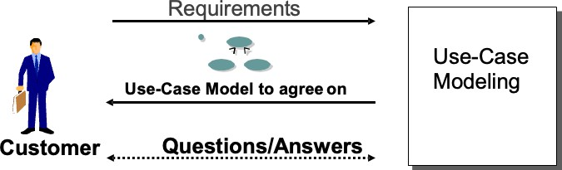
UML UML and Use Case Diagrams
Use Case Model
Actors and System Boundaries
Guidelines
Summary
A Use-Case Model is a model of the system in terms of all its Use Cases, Actors and Interactions
The use-case model is used as a contract with the customer.
Involves customers early in the development eﬀort.
Building a use-case model ensures understanding of the functional requirements.
Lecture 2: Use Case Modelling Object Oriented Software Engineering

Slide 3
Actors and System Boundaries
Guidelines
Summary
Use case modelling
Use Case Diagrams
Use Case Descriptions
Scenarios
Lecture 2: Use Case Modelling Object Oriented Software Engineering

Slide 4
UML UML and Use Case Diagrams
Aim and Objectives
Actors and System Boundaries
Guidelines
Summary
Aim: To understand how to write Requirements using Use cases
Objectives are to understand
The concept of an Actor
The concept of a Use Case
The concept of a Boundary
The concepts of a scenario
The anatomy of a use case
Lecture 2: Use Case Modelling Object Oriented Software Engineering

Slide 5
UML
Unified Modelling Language
The objective of UML is to assist in software development

Slide 6
What is the purpose of UML ?
Provide users with a ready-to-use, expressive visual modeling language so they can develop and exchange meaningful models.
Be independent of speciﬁc programming languages and development processes.
Provide a formal basis for understanding the modeling language.

Slide 7
What is the purpose of a model?
Create Designs and permit review and iteration of the designs
Provide Abstraction
Standard notation that is understandable by clients and users
Document the system

Slide 8
UML UML and Use Case Diagrams Actors and System Boundaries
What constitutes a good model?
Guidelines
Summary
A model should
use a standard notation
be understandable by clients and users
lead software engineers to have insights about the system
provide abstraction Models are used:
to help create designs
to permit analysis and review of those designs.
as the core documentation describing the system.
Lecture 2: Use Case Modelling Object Oriented Software Engineering

Slide 9
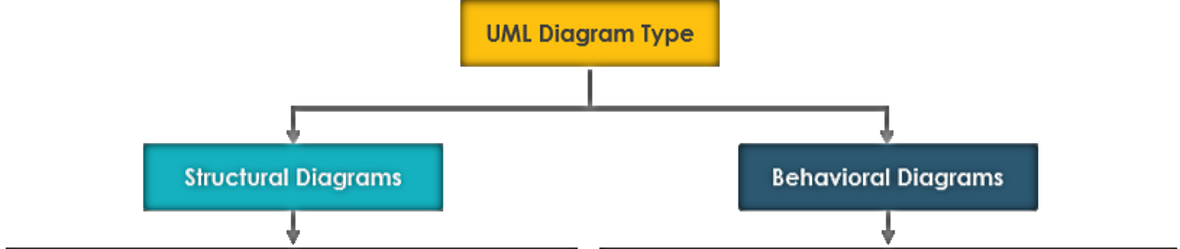
UML UML and Use Case Diagrams
UML Diagram Types
Actors and System Boundaries
Guidelines
Summary
Lecture 2: Use Case Modelling Object Oriented Software Engineering

Slide 10
UML UML and Use Case Diagrams
UML Diagram types
Actors and System Boundaries
Guidelines
Summary
UML Structural diagrams depict the elements of a
system that are independent of time and that convey the concepts of a system and how they relate to each other. The elements in these diagrams resemble the
nouns in a natural language, and the relationships that
connect them are structural relationships.
UML Behavioural Diagrams depict the elements of a
system that are dependent on time and that convey the dynamic concepts of the
system and how they relate to each other. The elements in these diagrams resemble the verbs in a natural
language and the
relationships that connect them typically convey the passage of time.
Lecture 2: Use Case Modelling Object Oriented Software Engineering

Slide 11
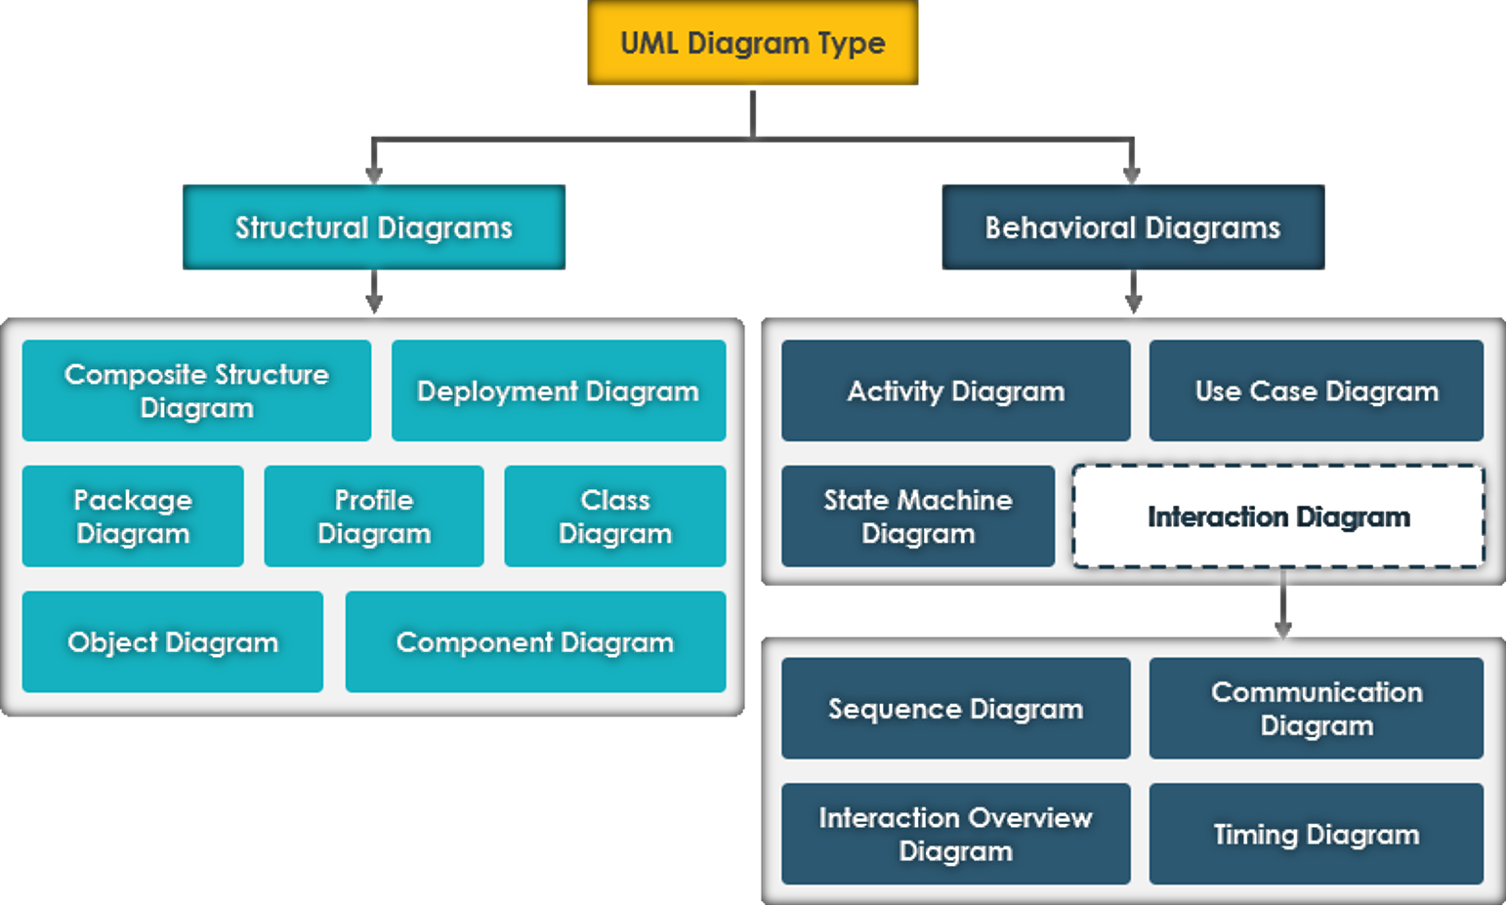
UML Diagram types

Slide 12
What is the purpose of Use Case ?
A Use Case represents one way to use the system by an actor
A Use Case describes the dialogue between an Actor and the system.
It describes what the system does in response to actions the Actor takes.
It provides meaningful, measurable value to a speciﬁc Actor.

Slide 13
What is the purpose of Use Case ?
The functionality of a system is deﬁned by use cases, each of which represents a speciﬁc way to use the system, that is, the behaviour of the system.
The description of a use case deﬁnes WHAT happens in the system when the use case is performed, not HOW it is performed.
When an actor uses the system, the system performs a use case

Slide 14
UML UML and Use Case Diagrams
Use Case Deﬁnition
Actors and System Boundaries
Guidelines
Summary
A use case instance is a sequence of transactions
performed by the system, which is initiated by a particular actor and yields a meaningful, measurable result of value to a particular actor.
A sequence of transactions. A transaction consists of a set of actions, decisions and stimuli transmissions to either the invoking actor or other actors
System performs. This means that the system provides and performs the use case. An actor communicates with a use-case instance of the system. Use Cases are always related to actors.
A meaningful, measurable result of value.
A use case should make sure that an actor can perform a task that has an
identiﬁable value. This is very important in determining the correct level or granularity for a use case. Correct level refers to achieving use cases that are not too small.
Lecture 2: Use Case Modelling Object Oriented Software Engineering

Slide 15
UML UML and Use Case Diagrams
Use Case Deﬁnition (Cont.)
Actors and System Boundaries
Guidelines
Summary
A particular actor. The actor is the key to ﬁnding the correct use case, especially because the actor helps you avoid use cases that are too large. It is important to begin with individual (human) actors, or instances of actors. r.
Lecture 2: Use Case Modelling Object Oriented Software Engineering

Slide 16
Actors
To fully understand the purpose of a system you have to know who the system is for, and who will use it.
In Object theory, the diﬀerent types of users are represented by actors.
Any other system which interacts with the system being developed is also represented by an actor; (thus actors delimit the system).

Slide 17
UML
Actor
UML and Use Case Diagrams
Actors and System Boundaries
Guidelines
Summary
Actors are not part of the system
Actors represent roles users play
Actors can actively exchange information with a system
Just receive information, just send or both
Lecture 2: Use Case Modelling Object Oriented Software Engineering

Slide 18
You have been asked to gather requirements for a learning platform for a college ( e.g. Moodle )
Identify some actors for the system

Slide 19
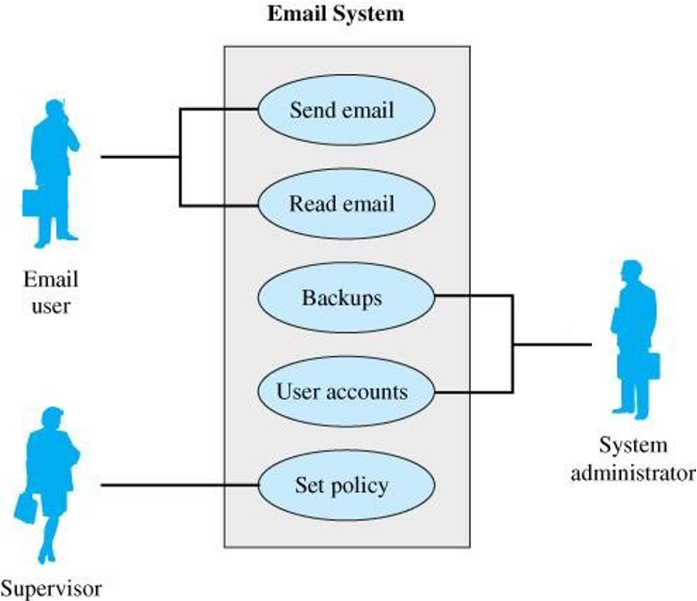
UML UML and Use Case Diagrams
UML- Use Case Diagram
Actors and System Boundaries
Guidelines
Summary
Use Case Diagrams model at a high level
Models how users interact with major components of a system
Lecture 2: Use Case Modelling Object Oriented Software Engineering

Slide 20
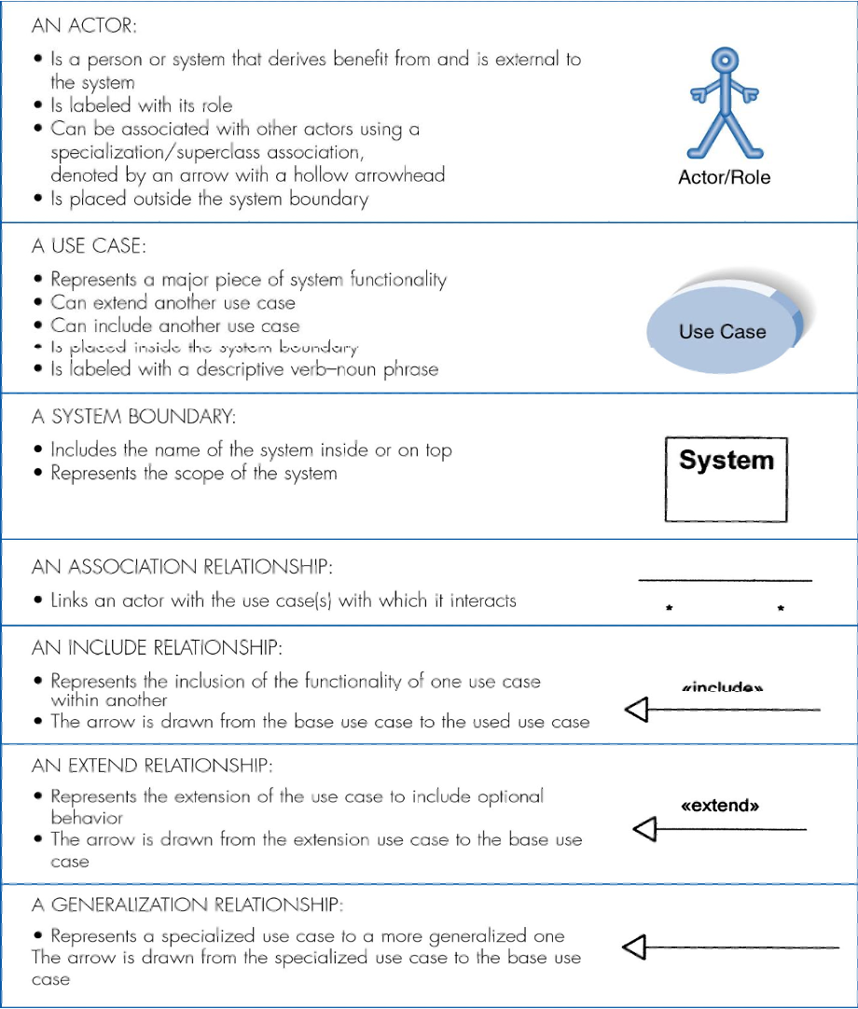
UML UML and Use Case Diagrams
Syntax for Use Case Diagram
Actors and System Boundaries
Guidelines
Summary
Lecture 2: Use Case Modelling Object Oriented Software Engineering

Slide 21
UML UML and Use Case Diagrams
Basic Concepts
Actors and System Boundaries
Guidelines
Summary
An Actor represents anything outside the system that interacts with the system.
A Use Case instance is a sequence of transactions performed by the system, which is initiated by a particular actor and
yields a meaningful, measurable result of value to a particular actor.
Lecture 2: Use Case Modelling Object Oriented Software Engineering

Slide 22
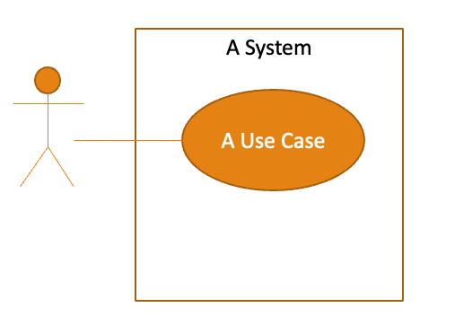
UML UML and Use Case Diagrams
Creating a the Use Case Diagram
Actors and System Boundaries
Guidelines
Summary
Start with system boundary
Place elements in order to be easy to read
Place actors on the diagram
Conclude by connecting actors to use cases by lines
Lecture 2: Use Case Modelling Object Oriented Software Engineering

Slide 23
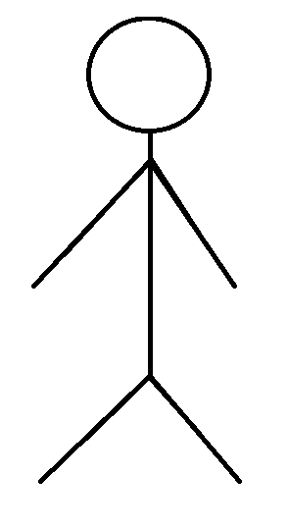
UML UML and Use Case Diagrams
Actor vs User
Actors and System Boundaries
Guidelines
Summary
An actor is a role not a person or a thing
The name of the actor should represent, as clearly as possible, the actors role, for example ‘operator’, or ‘subscriber’. Make sure that there is little risk of confusing one actors name with another at a future stage of the work.
The diﬀerence between an actor and a user of the system is that an actor
represents a particular type of user rather than a real physical user. The same user can act as several diﬀerent actors. Several users can act as the same actor.
Teacher
Lecture 2: Use Case Modelling Object Oriented Software Engineering

Slide 24
UML UML and Use Case Diagrams
Actor Categories
Actors and System Boundaries
Guidelines
Summary
Actors fall into one of the following categories:
Primary (human) users that execute the main functionality
Human users that execute the secondary functions of the system, such as system administration functions
External hardware used by the system
Other systems interacting with the system
Lecture 2: Use Case Modelling Object Oriented Software Engineering

Slide 25
System Boundary
The system boundary is potentially the entire system as defined in the requirements document.
For large and complex systems, each module may be the system boundary.
For example, for an ERP system for an organization, each of the modules such as personnel, payroll, accounting, etc. can form a system boundary for use cases specific to each of these business functions.
The entire system can span all these modules depicting the overall system boundary

Slide 26
System boundary examples
System Name
Learning Platform
ATM

Slide 27
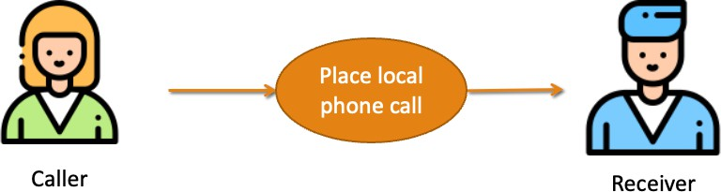
UML UML and Use Case Diagrams
Interaction with the System
Actors and System Boundaries
Guidelines
Summary
An association between an Actor and a Use Case indicates that they interact. The direction of the arrow indicates who initiates the communication
Lecture 2: Use Case Modelling Object Oriented Software Engineering

Slide 28
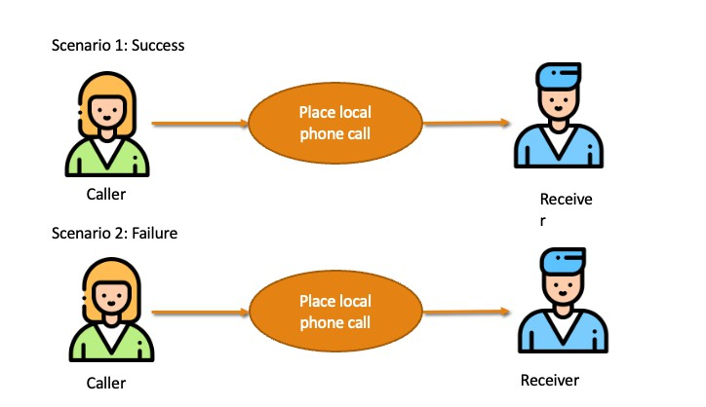
UML
Scenarios
UML and Use Case Diagrams
Actors and System Boundaries
Guidelines
Summary
One Use Case can have multiple scenarios For example:
Call takes place
Line is busy
Lecture 2: Use Case Modelling Object Oriented Software Engineering

Slide 29
Identify some use cases for the learning platform
Draw a use case diagram for the learning platform
( pick 2 use cases )

Slide 30
Use Case Descriptions

Slide 31
UML UML and Use Case Diagrams
Use Case Descriptions
Actors and System Boundaries
Guidelines
Summary
Describe basic functions of the system
What the user can do
How the system responds
Describe the activities of a system without specifying how the activities are implemented.
Developed working with users for content.
Lecture 2: Use Case Modelling Object Oriented Software Engineering

Slide 32
UML UML and Use Case Diagrams Actors and System Boundaries
Guidelines for Creating Use Case Descriptions
Guidelines
Summary
Write each step in “SVDPI”form. Subject Verb
Direct-Object Preposition Indirect-Object (Customer arrives at checkout with items to buy)
Clarify initiator and receivers of action
Write from independent observer perspective Write at same level of abstraction
Ensure a sensible set of steps
Apply Keep it Short and Simple (KISS) principle liberally
Write repeating instructions after the set of steps to be repeated.
Lecture 2: Use Case Modelling Object Oriented Software Engineering

Slide 33
UML UML and Use Case Diagrams Actors and System Boundaries
Anatomy of a Use Case Description
Guidelines
Summary
Name
Brief description
Flow of events
Special Requirements
Pre/Post Conditions activation and termination
Associations to Actors/Use Cases
Lecture 2: Use Case Modelling Object Oriented Software Engineering

Slide 34
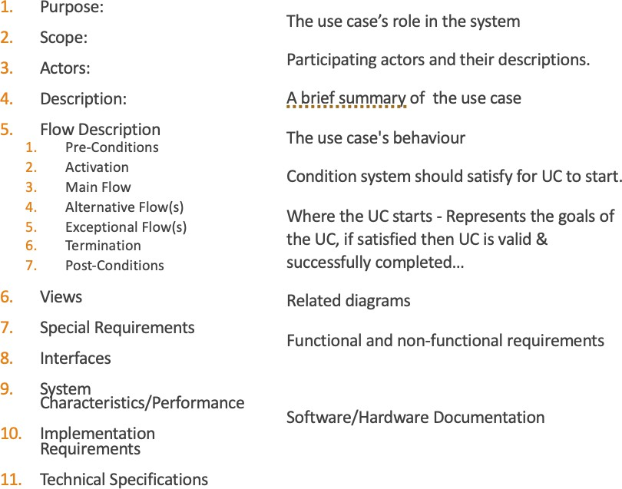
UML UML and Use Case Diagrams
Use Case Template (General)
Actors and System Boundaries
Guidelines
Summary
Lecture 2: Use Case Modelling Object Oriented Software Engineering

Slide 35
UML UML and Use Case Diagrams
Flow of Events
Actors and System Boundaries
Guidelines
Summary
A Use Case description has a ﬂow of events:
The ﬂow of events can be considered to have a main ﬂow and a number of sub-ﬂows.
Sub-ﬂows can be used to capture :
Alternative behaviour (alternative ﬂows)
Exceptional behaviour (exceptional ﬂows)
Optional behaviour (Extends)
Common behaviour (Uses)
In agile development a single flow is called a scenario
Lecture 2: Use Case Modelling Object Oriented Software Engineering

Slide 36
Scenario
Textual narrative describing the interaction between the user and the system
AKA flow ( part of use case description)
AKA user story ( agile concept)
Concrete example of a use case interaction
Not formally part of a UML diagram

Slide 37
Scenario:
Teacher Posting New Lecture Content on Learning Platform
Actors: Teacher
Preconditions:
Teacher is logged into the platform and has access to the course.
Basic Flow:
The teacher navigates to the course page.
The teacher turns on editing mode.
The teacher selects the option to add a new resource.
The teacher uploads the lecture content (e.g., a PDF or video file).
The teacher saves the changes, and the new content appears on the course page.
Postconditions:
The lecture content is successfully uploaded and visible to students.

Slide 38
Identify an exceptional or alternative flow /scenario for a teacher posting content on the platform
Write a scenario for an exceptional flow/scenario

Slide 39
UML UML and Use Case Diagrams
What have we learned?
Actors and System Boundaries
Guidelines
Summary
Actor: An Actor represents anything outside the system that interacts with the system
Use Case: A Use Case instance is a sequence of transactions performed by the system, which is initiated by a particular actor and yields a meaningful, measurable result of value to a particular actor.
System boundary depicts the scope of the system being described
A scenario describes what happens during an actual occurrence of a use case.
Lecture 2: Use Case Modelling Object Oriented Software Engineering

Slide 40
UML UML and Use Case Diagrams
End of Lecture
Actors and System Boundaries
Guidelines
Summary
Questions ?
Lecture 2: Use Case Modelling Object Oriented Software Engineering

